Slide 1
FULL STACK APPLICATION DEVELOPMENT (24SDCS02) Skill Swap-A role based exchange system using java&springboot
Team Members
Name:
M Aditya Vardhan
G B JAI RAJ
M HARI HARAN
B JAYASIMHA
Roll No:
2420090094
2420030414
2420030243
2420080035
Under the Esteemed Guidance of
Name of the OOP faculty name with designation and department
Dr.S Spandana

Slide 2
Contents
Abstract
Introduction
Literature survey
Problem Statement and Objectives
Hardware and Software requirements
Results
Conclusion
Future Scope

Slide 3
Abstract
Project Title: SkillSwap – A Role-Based Service Exchange System
This project presents the design and development of SkillSwap, a peer-to-peer skill exchange platform built using Spring Boot and MySQL. The platform addresses a common challenge faced by students who want to learn new skills but have limited access to affordable learning resources, while many students possess valuable skills that can benefit others. Most existing learning platforms primarily focus on paid courses and lack a structured environment for mutual skill sharing.
SkillSwap provides a secure web-based platform where users can register and authenticate through a login and signup system. Authenticated users can list the skills they offer, explore skills shared by others, and send exchange requests based on mutual interests. Once a request is accepted, users coordinate externally to exchange knowledge, while the system tracks the progress of each exchange.
The application implements role-based access control and supports full CRUD (Create, Read, Update, Delete) operations for users, skills, and exchange requests. A relational database ensures efficient storage, retrieval, and data integrity. Additionally, an admin module allows monitoring of users and management of skill listings.

Slide 4
Introduction
SkillSwap is a web-based peer-to-peer skill exchange platform developed using Spring Boot and MySQL. The platform enables users to exchange skills without monetary transactions.
In today’s digital era, many students want to learn new skills but cannot afford paid platforms. At the same time, many students possess valuable skills they can share. SkillSwap bridges this gap by creating a structured environment for mutual learning.
The system provides:
Secure user registration and login
Role-based access control
Skill listing and management
Skill exchange request system
Admin monitoring dashboard
This project demonstrates core Full Stack Development concepts such as authentication, REST API integration, database connectivity, and responsive UI design.

Slide 5
Literature Survey
Several online platforms support learning and freelancing, such as:
Udemy – Offers paid online courses.
Coursera – Provides certification-based courses.
Fiverr – Allows service exchange but with monetary transactions.
Skillshare – Subscription-based learning platform.
Limitations of Existing Systems:
Mostly paid services
No structured peer-to-peer skill exchange
No mutual barter-based learning model
Limited focus on student collaboration
SkillSwap overcomes these limitations by introducing a role-based, non-monetary skill exchange system.

Slide 6
Problem Statement and Objectives
Many students face difficulty in accessing affordable learning resources. Existing platforms focus on paid courses and do not provide a structured system for mutual skill exchange.
There is a need for:
A secure platform
Peer-to-peer skill sharing
Role-based access control
Request tracking system
Administrative monitoring
SkillSwap aims to solve this problem by creating a web-based system that allows users to exchange skills based on mutual interest without financial transactions.

Slide 7
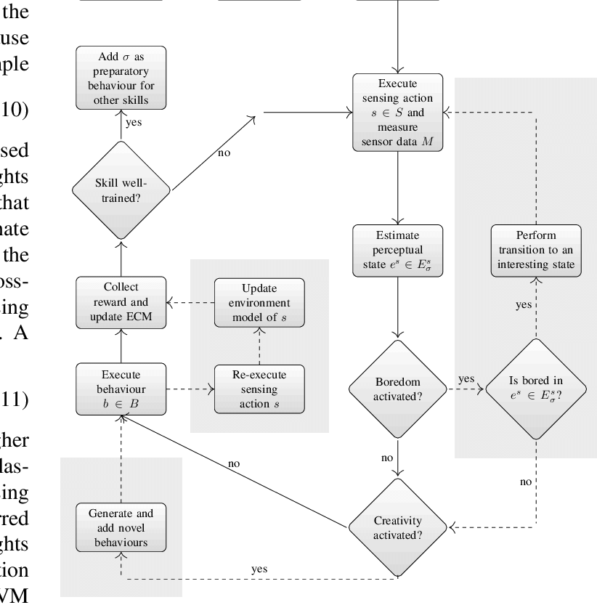

Flow Chart

Slide 8
Results
After successful implementation, the system achieved:
✅ Secure user authentication ✅ Successful CRUD operations ✅ Efficient database connectivity ✅ Skill request tracking system ✅ Admin monitoring panel ✅ Responsive user interface
Observed Outcomes:
Smooth frontend-backend communication via REST APIs
Proper role-based access control
Efficient data storage and retrieval
Reduced dependency on paid learning platforms
The system was tested for functionality, usability, and performance, and all modules worked as expected.

Slide 9
Hardware and Software requirements
🖥️ Hardware Requirements
Processor: Intel i3 or above
RAM: Minimum 4 GB
Hard Disk: 20 GB free space
Internet Connection
Backend:
Java (JDK 8 or above)
Spring Boot
Spring Data JPA
REST APIs
Database:
MySQL
Frontend:
HTML
CSS
JavaScript
Bootstrap
Development Tools:
Eclipse IDE
Visual Studio Code

Slide 10
Conclusion
SkillSwap successfully implements a role-based peer-to-peer skill exchange system using modern full-stack technologies.
The platform:
Enables collaborative learning
Eliminates financial barriers
Ensures secure authentication
Supports efficient database management
Provides admin control for system monitoring
This project demonstrates strong understanding of backend development, database integration, RESTful services, and frontend design. SkillSwap is scalable and can be extended with features like chat integration, notifications, mobile app support, and rating systems.

Slide 11
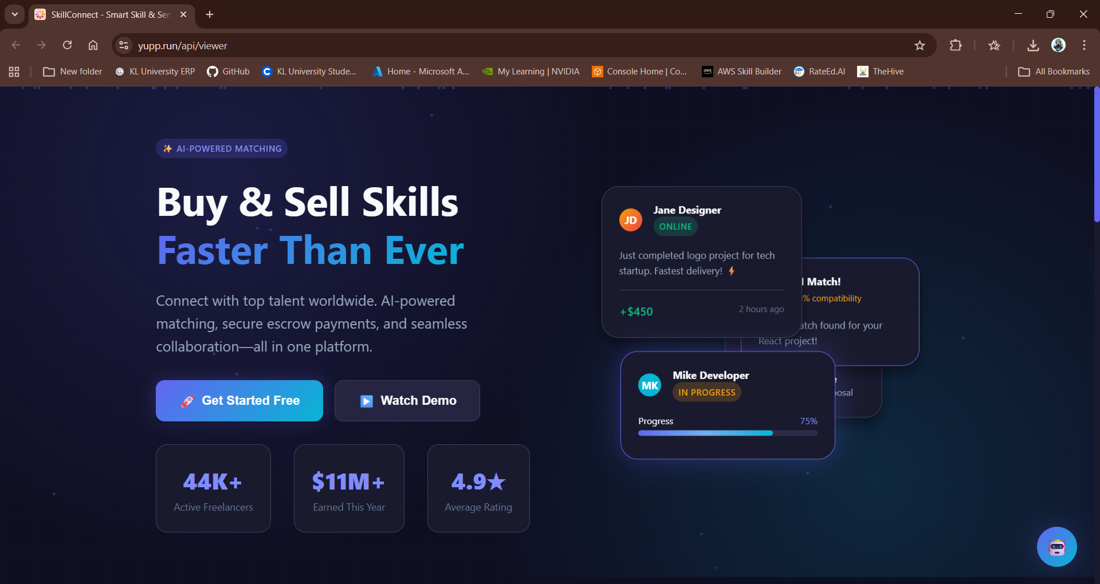

Slide 12
Thankyou

